Slide 1
Tad’s Ham
© COPYRIGHT 2024 by Roxie Sporleder
Permission is granted to add, delete, or resize the pictures on the following slides.
^{Published by TeachingBasics} Battle Ground, Washington 98604 ^{E-mail: teachingbasics@mcn.net}
Photographs are from www.freepik.com as a premium user.
Slides 2 and 3: Kinds of sandwiches

Slide 2
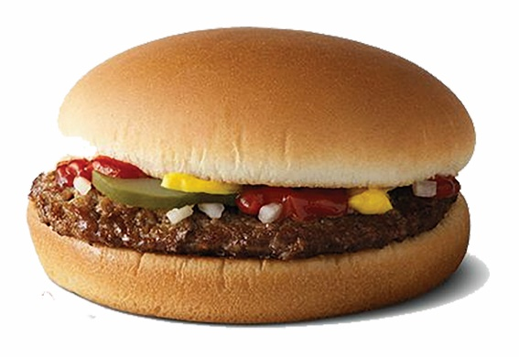
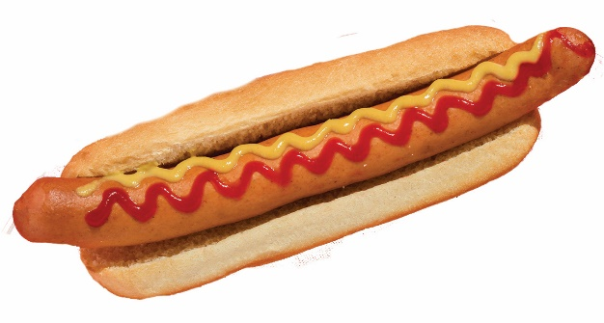
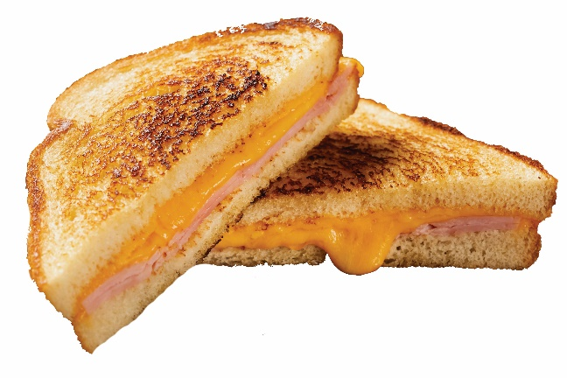
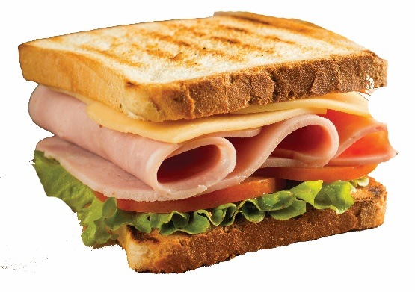
Sandwiches
hamburger
hot dog
grilled cheese sandwich
deli chicken and cheese sandwich

Slide 3
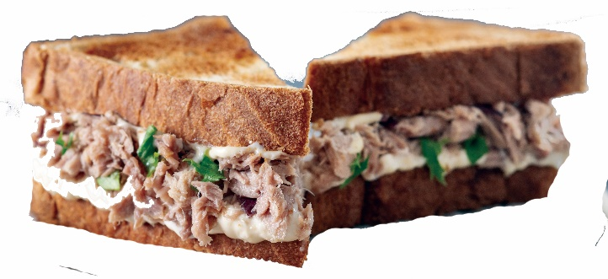
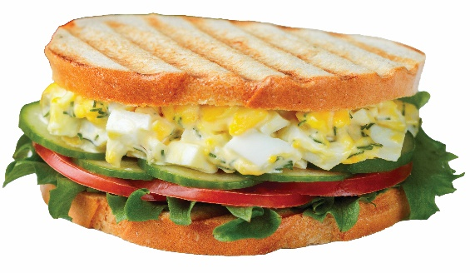
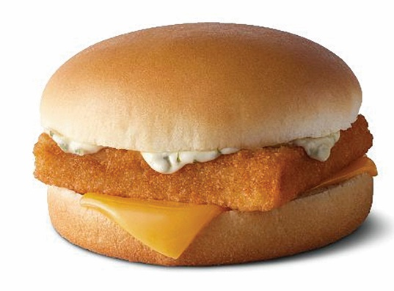
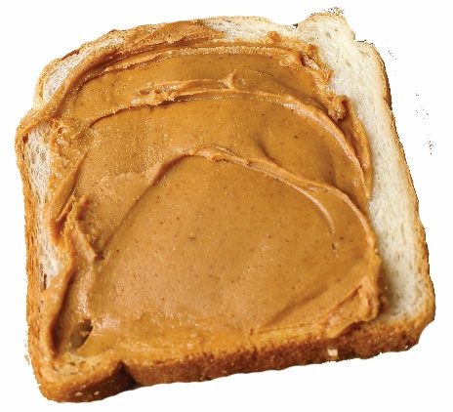
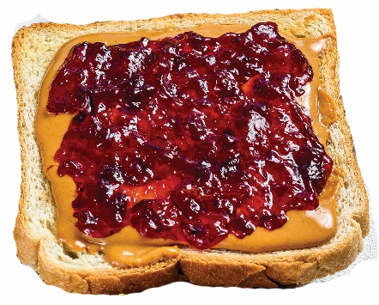
Sandwiches
tuna fish sandwich
egg salad sandwich
peanut butter sandwich
peanut butter and jelly sandwich
fish sandwich

