Slide 1
The Red Hen
© COPYRIGHT 2024 by Roxie Sporleder
Permission is granted to add, delete, or resize the pictures on the following slides.
^{Published by TeachingBasics} Battle Ground, Washington 98604 ^{E-mail: teachingbasics@mcn.net}
Photographs are from www.freepik.com as a premium user.
^{Slide 2: Chicken family,}
Slide 3: What chickens eat and feeding chickens
Slide 4: What chickens need—a nest and exercise outside
Slide 5: What chickens give us—eggs
Slide 6: What we make from eggs

Slide 2
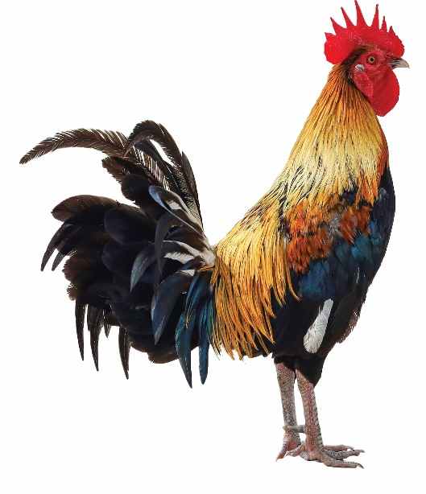
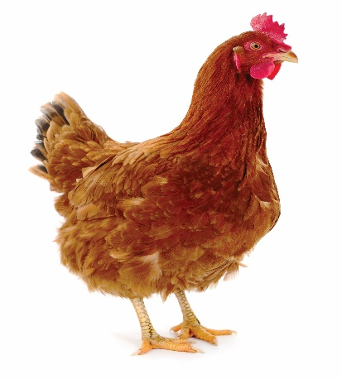
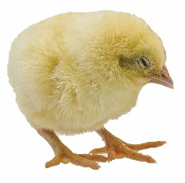
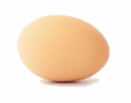
Chickens
rooster
hen
chick

Slide 3
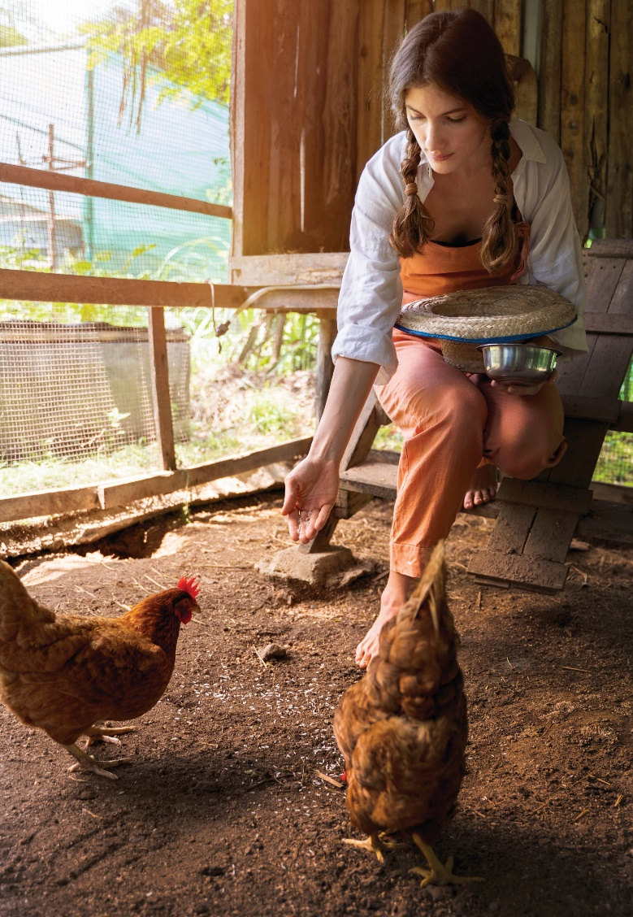
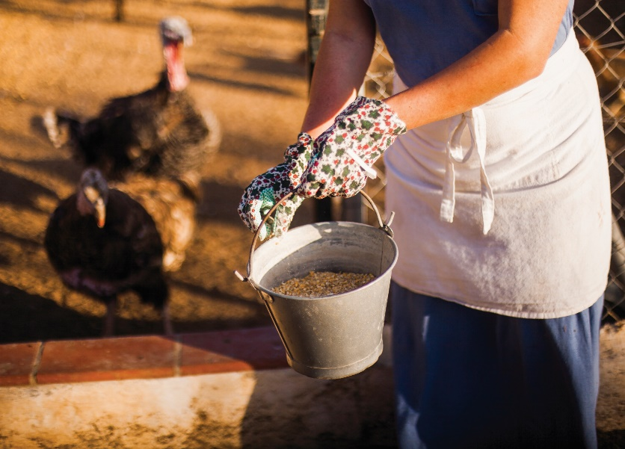
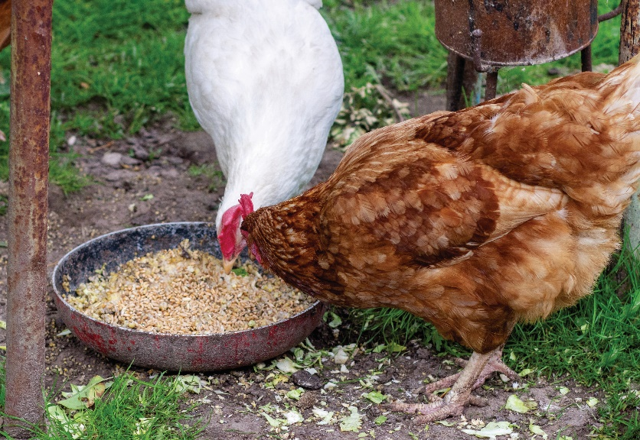
Chickens

Slide 4
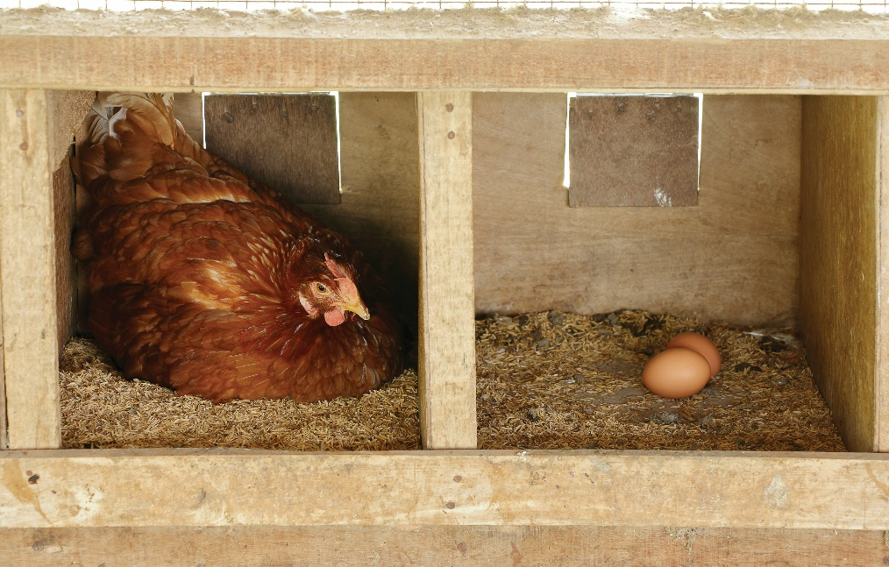
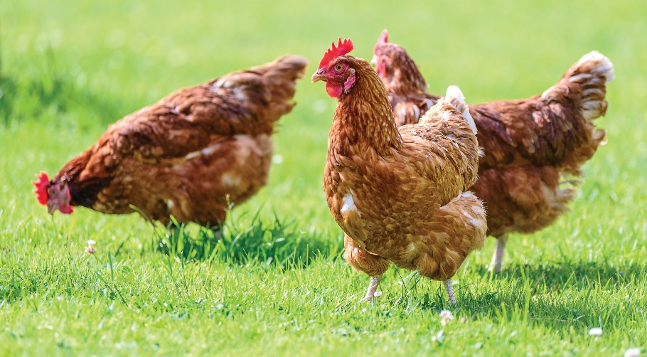
Chickens

Slide 5
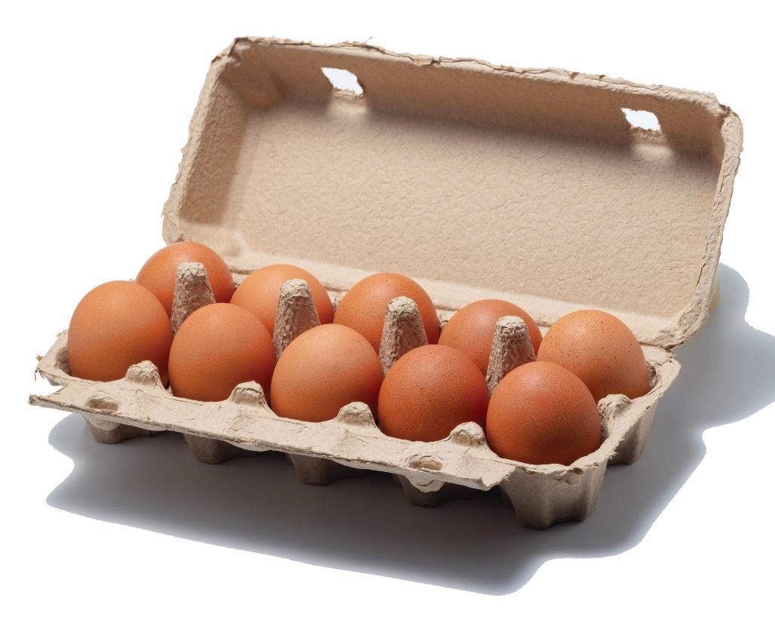
Eggs

Slide 6
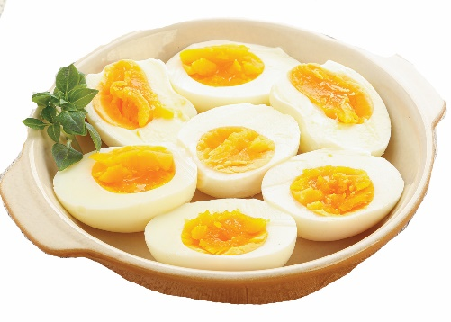
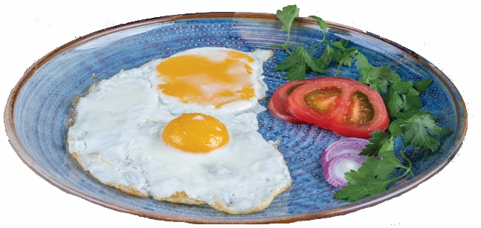
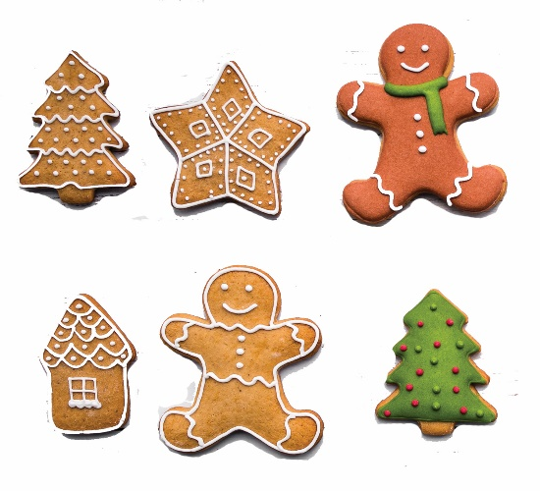
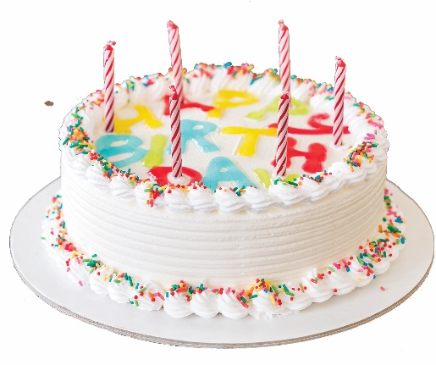
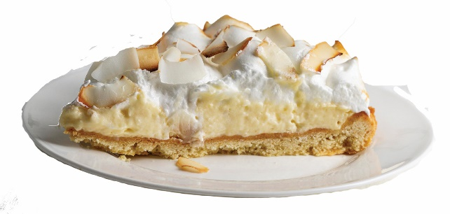
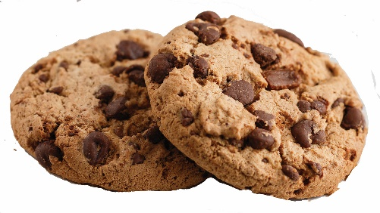
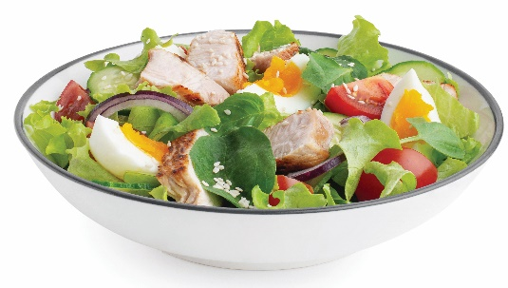
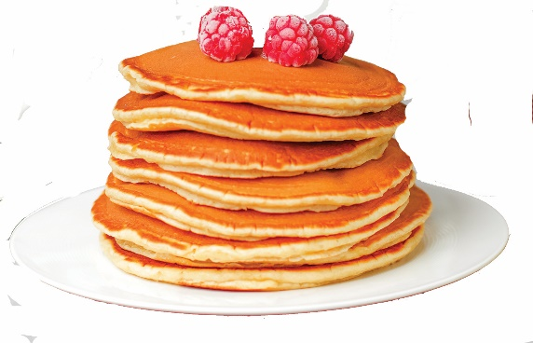
Eggs

