Slide 1
The Cat and the Bug
© COPYRIGHT 2024 by Roxie Sporleder
Permission is granted to add, delete, or resize the pictures on the following slides.
^{Published by TeachingBasics} Battle Ground, Washington 98604 ^{E-mail: teachingbasics@mcn.net}
Photographs are from www.freepik.com as a premium user.
^{Slide 2: Cats as pets}
^{Slide 3: What cats need}
Slides 4 and 5: Cats chasing and hunting.

Slide 2
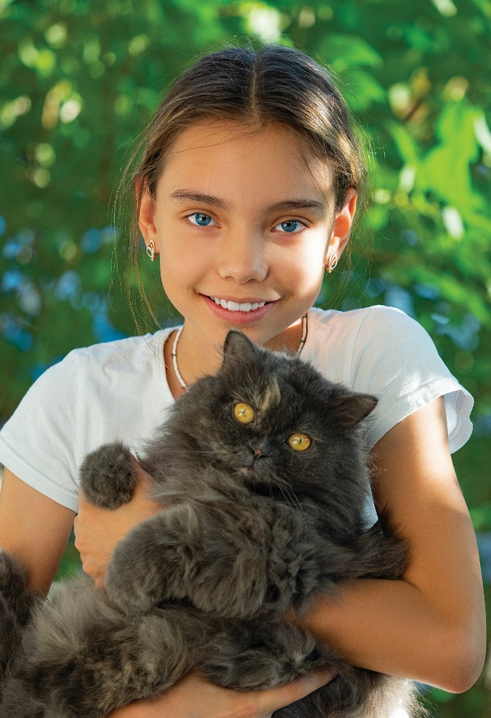
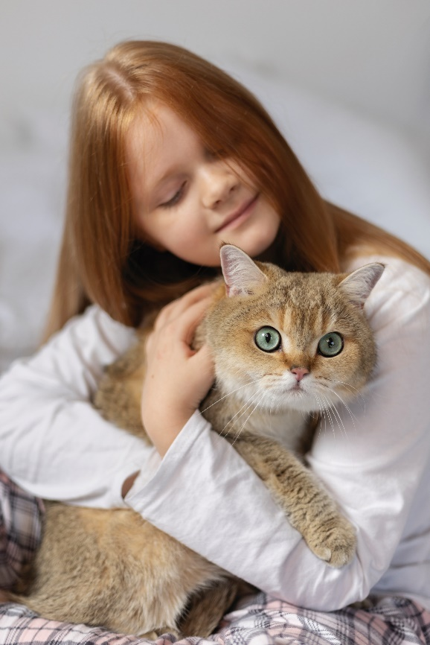
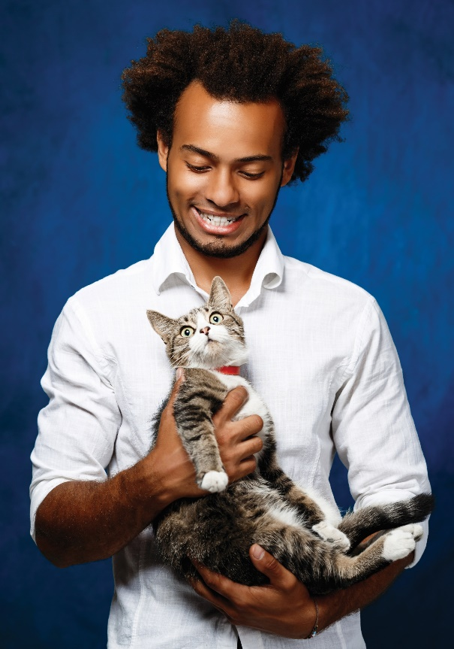
Cats

Slide 3
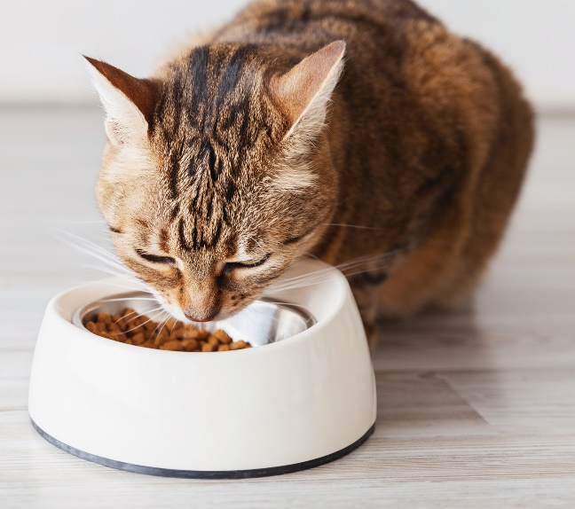
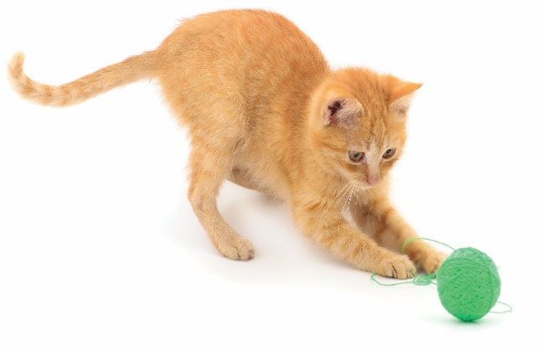
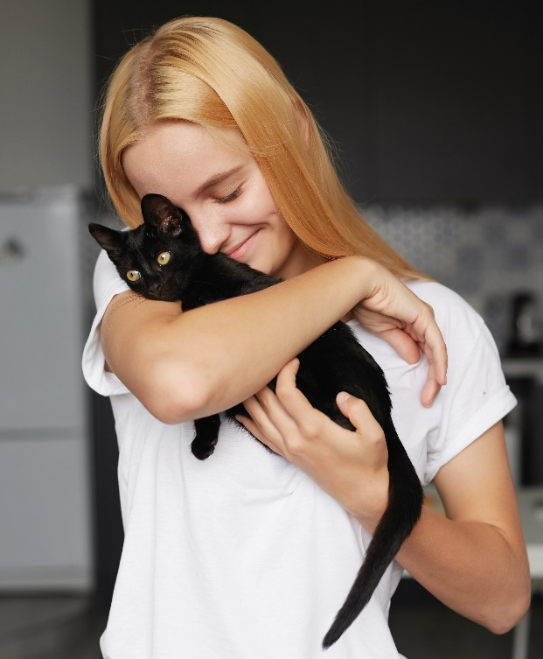
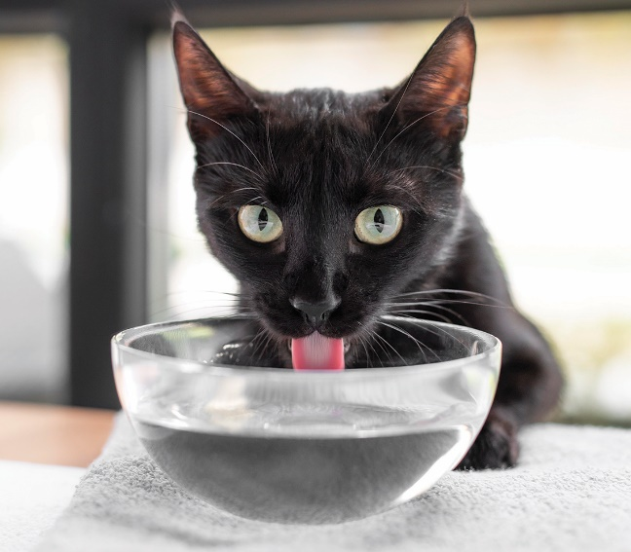
Cats

Slide 4
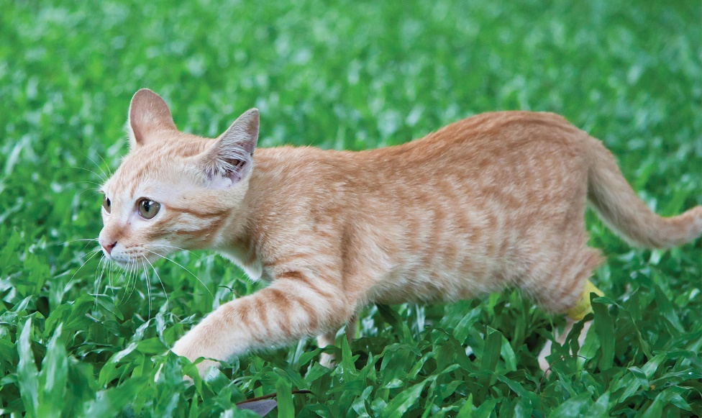
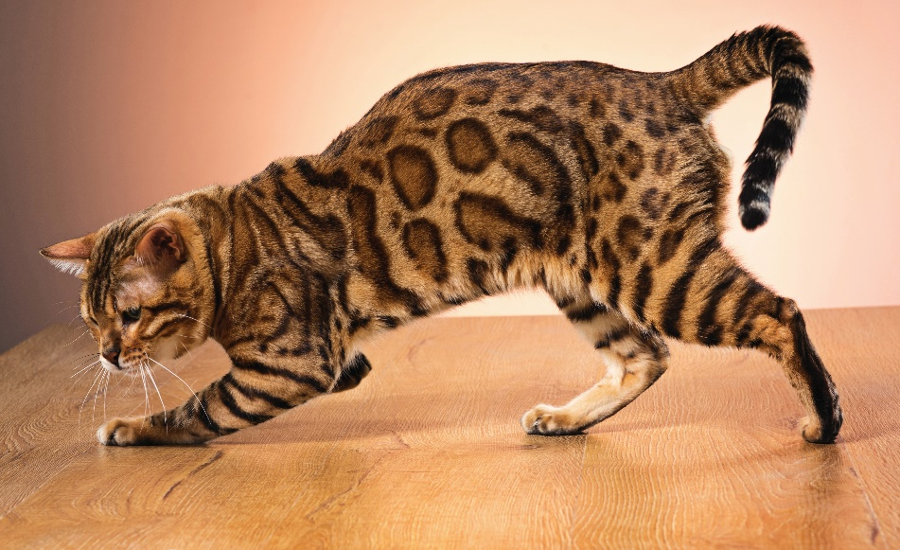
Cats are hunters.

Slide 5
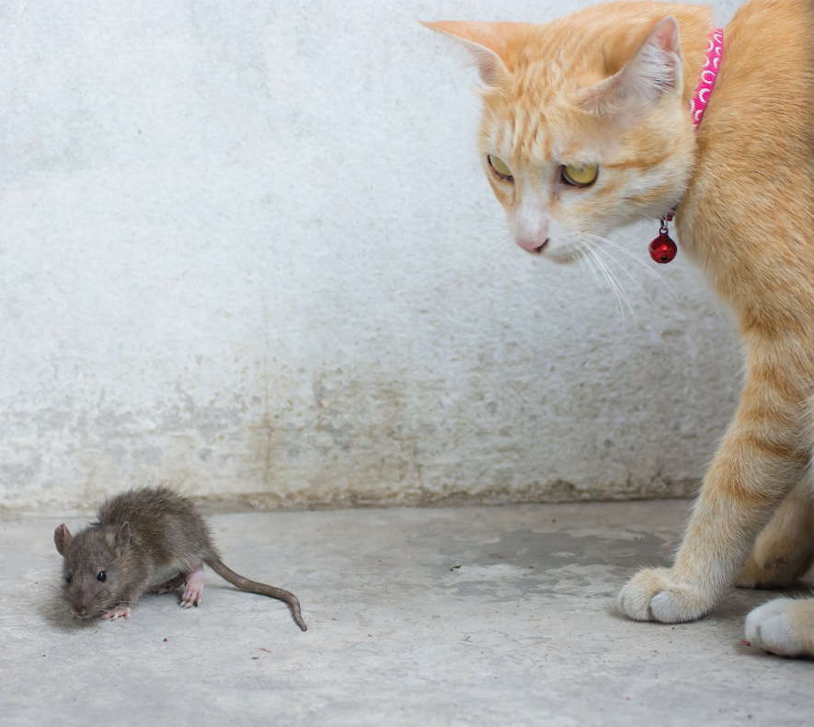
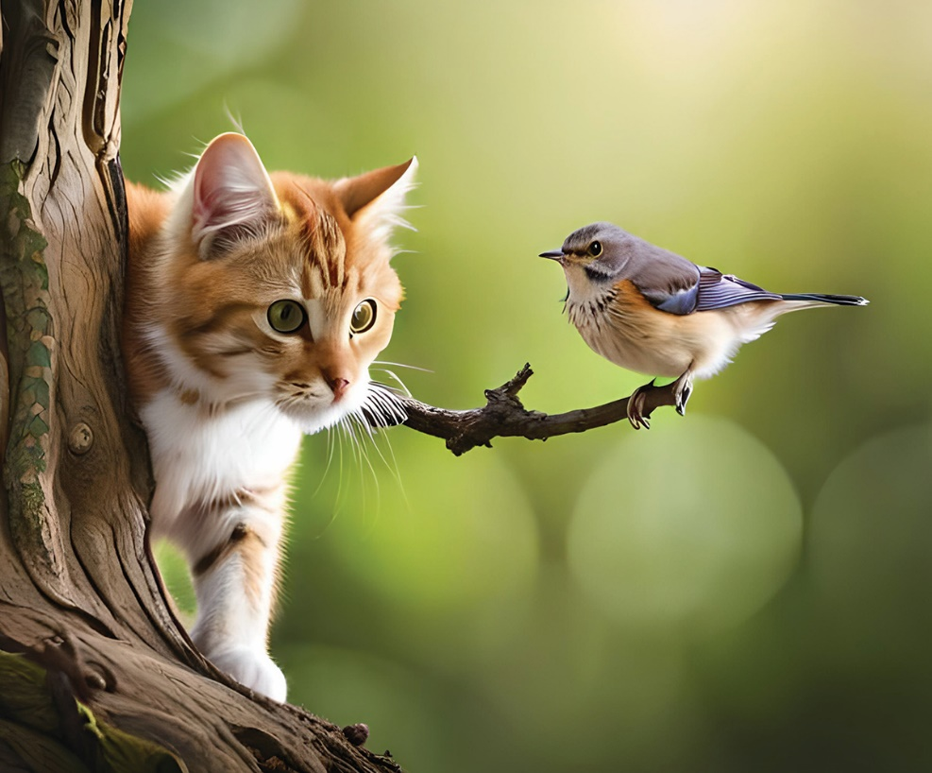
Cats

Slide 6
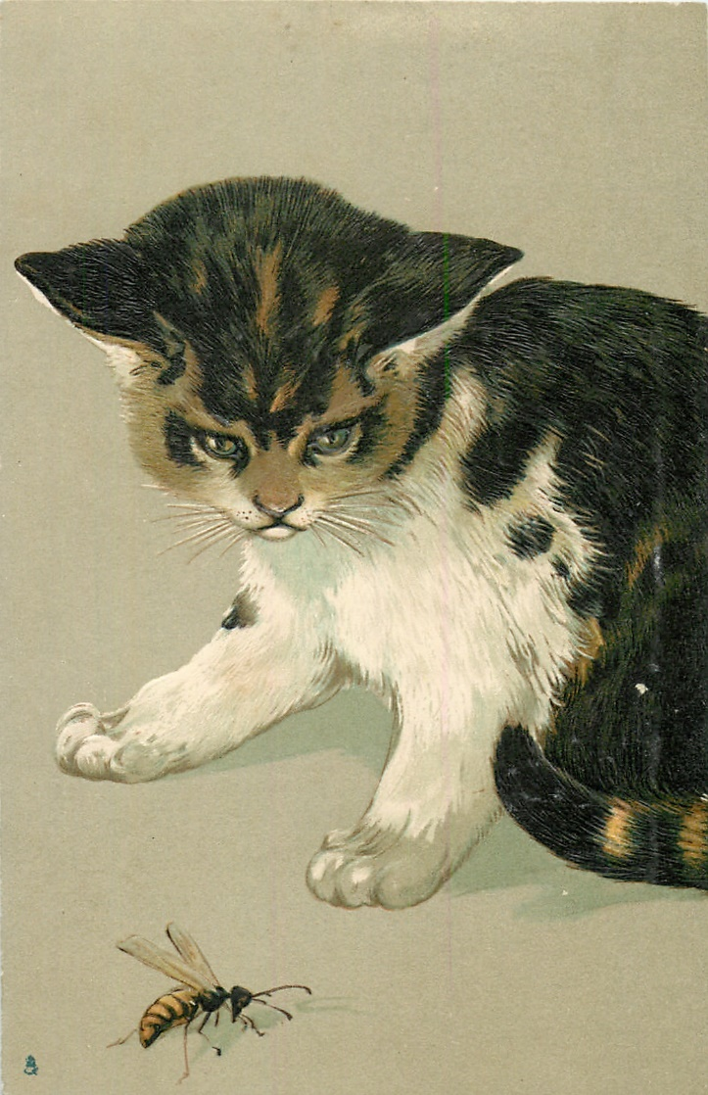
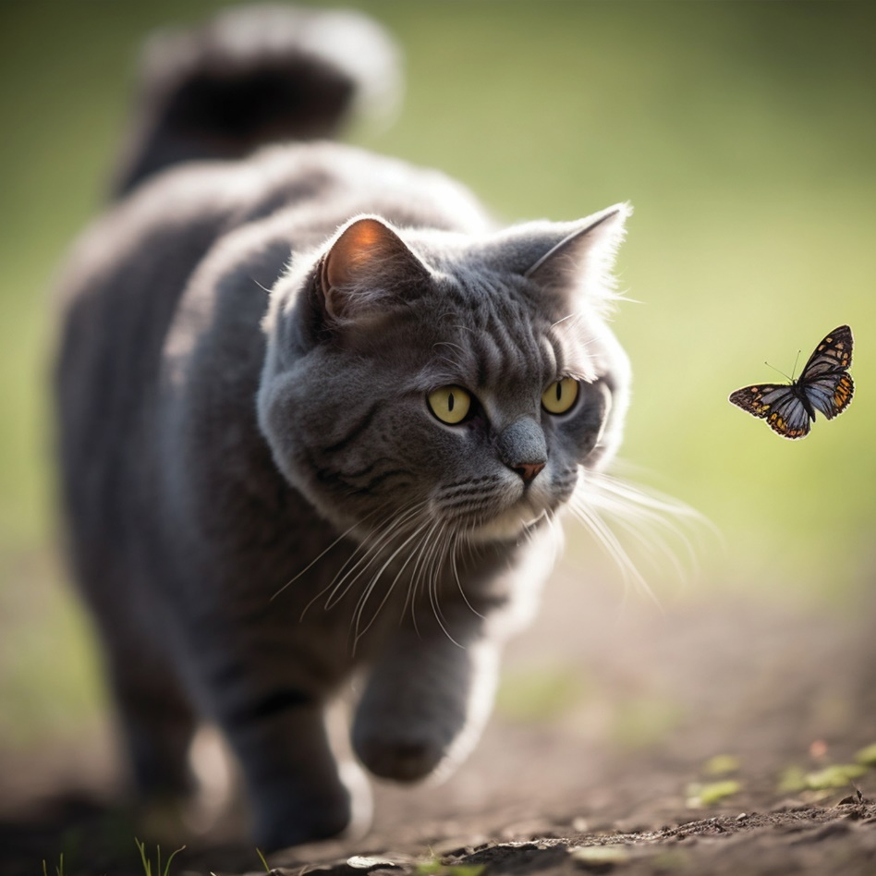
Cats

