Slide 1
The Red Sled
© COPYRIGHT 2024 by Roxie Sporleder
Permission is granted to add, delete, or resize the pictures on the following slides.
^{Published by TeachingBasics} Battle Ground, Washington 98604 ^{E-mail: teachingbasics@mcn.net}
Photographs are from www.freepik.com as a premium user.
Slide 2: What it looks like when snowing
Slide 3: Four forms of water: water, ice, steam, snow
Slides 4: Snowflake. What do you notice about all the snowflakes?
Slides 5, 6, and 7: Fun n the snow. Skiing, snowboarding, .sledding, making snowman, making snow angel
Slide 8: What you need to have fun (sled, saucer, skis, snowboard)
Slide 9: Clothes to wear when it snows

Slide 2
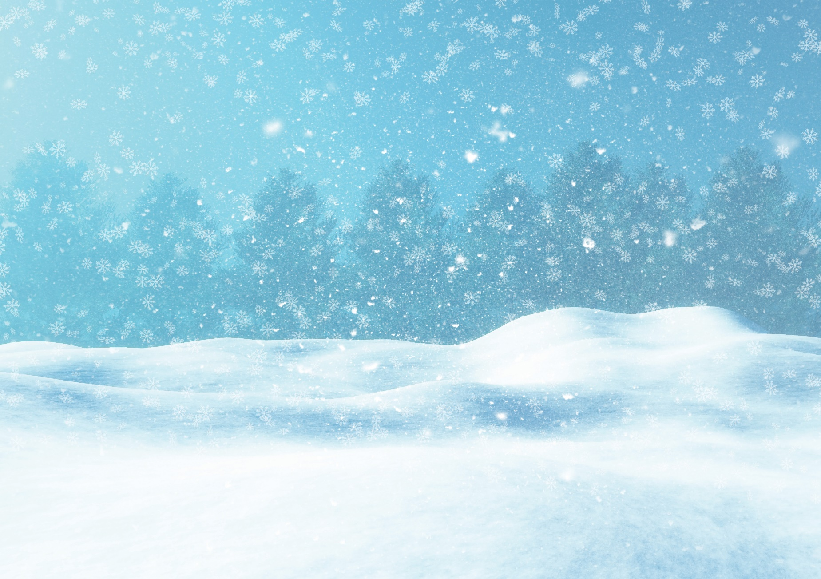
Snow

Slide 3
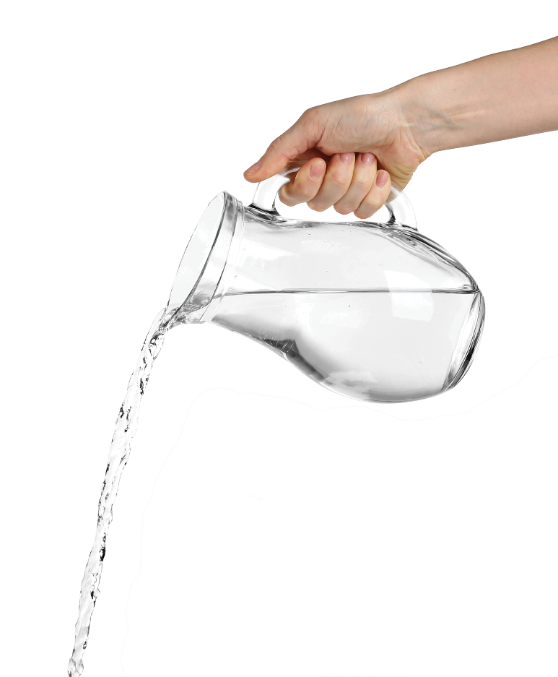
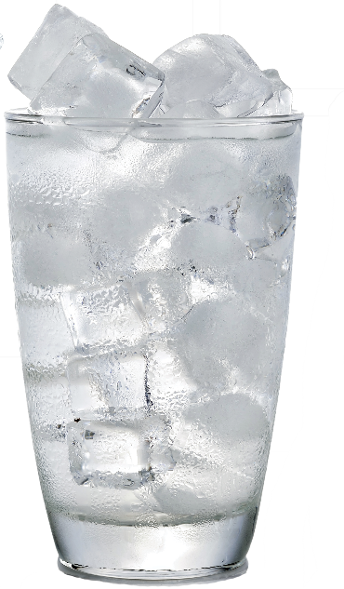
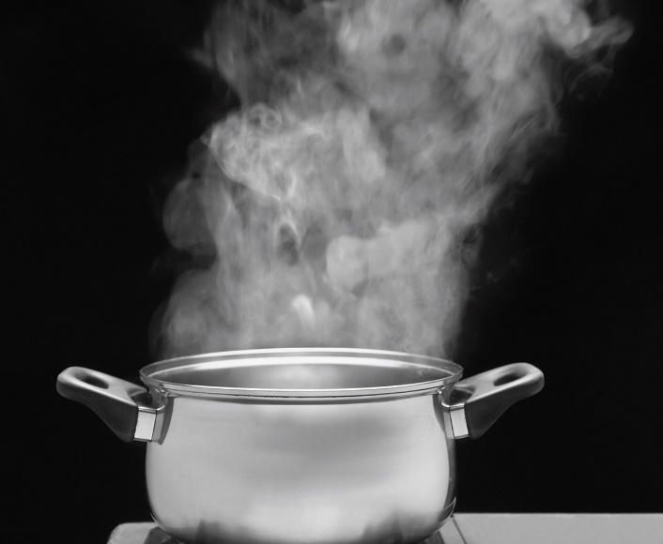
Snow

Slide 4
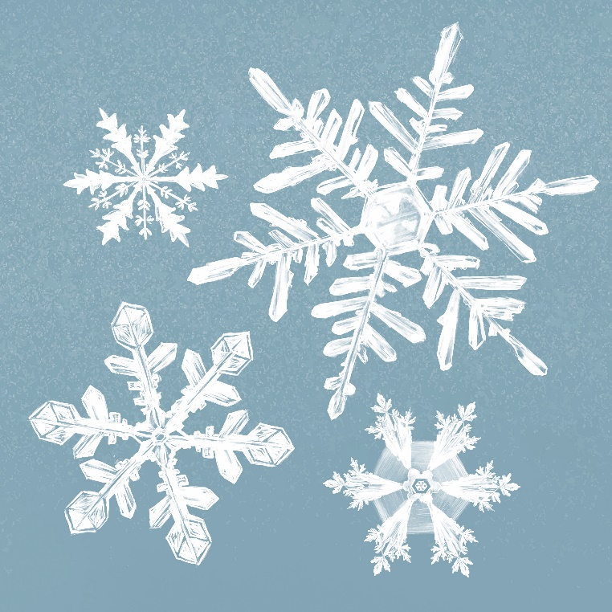
Snow

Slide 5
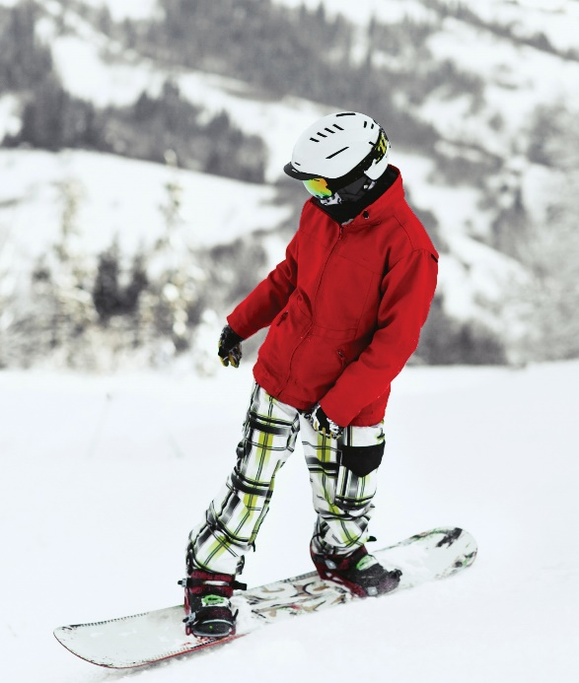
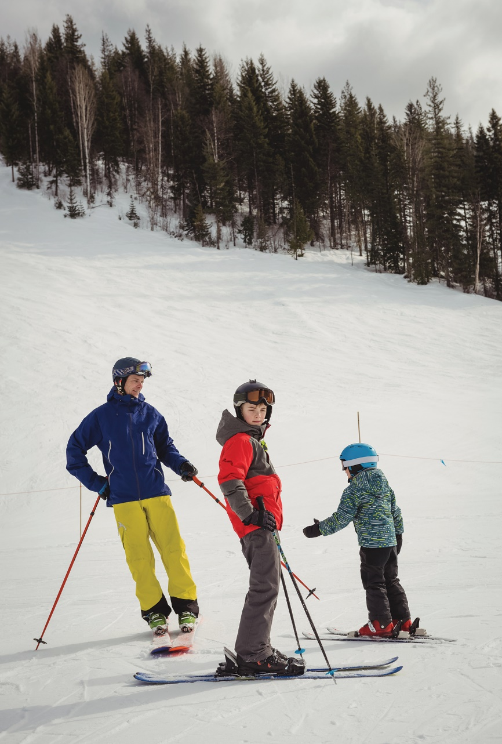
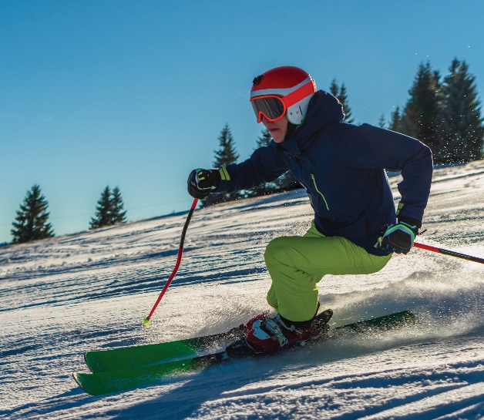
Snow

Slide 6
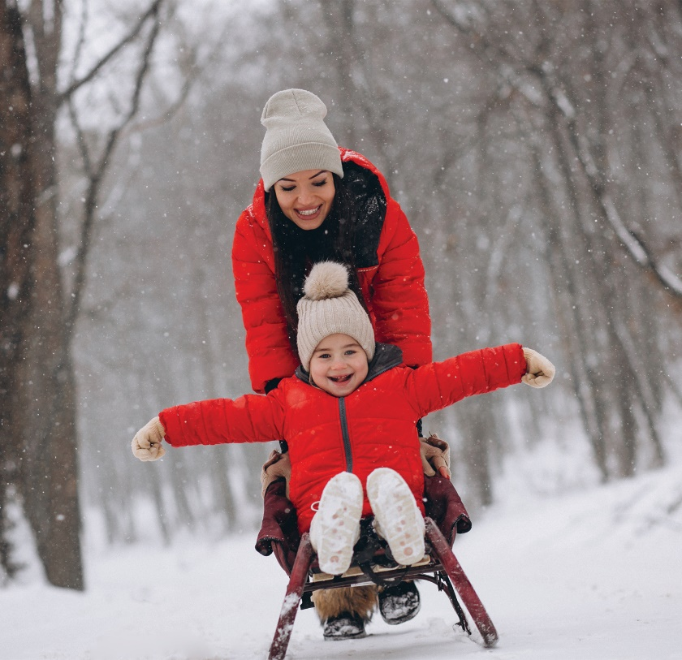
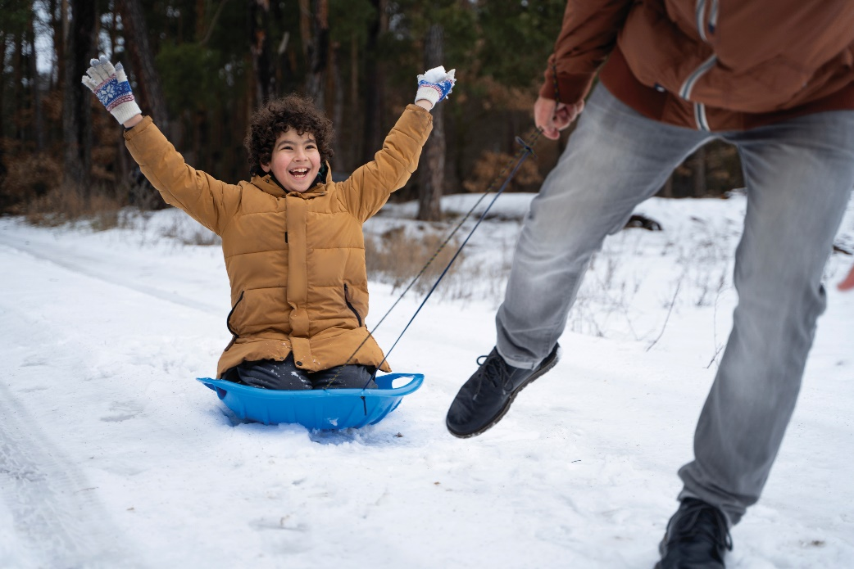
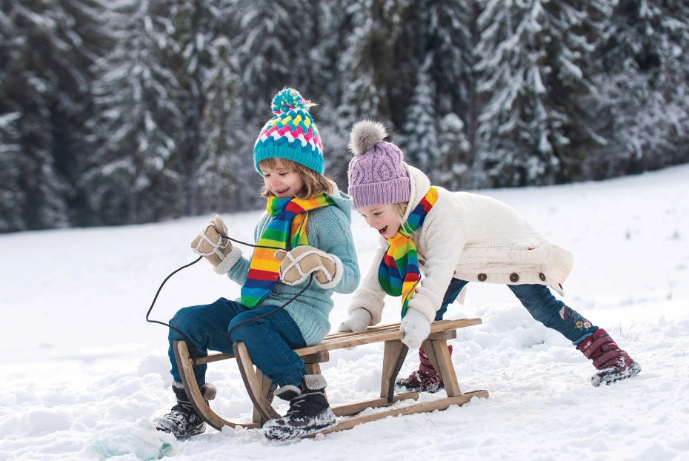
Snow

Slide 7
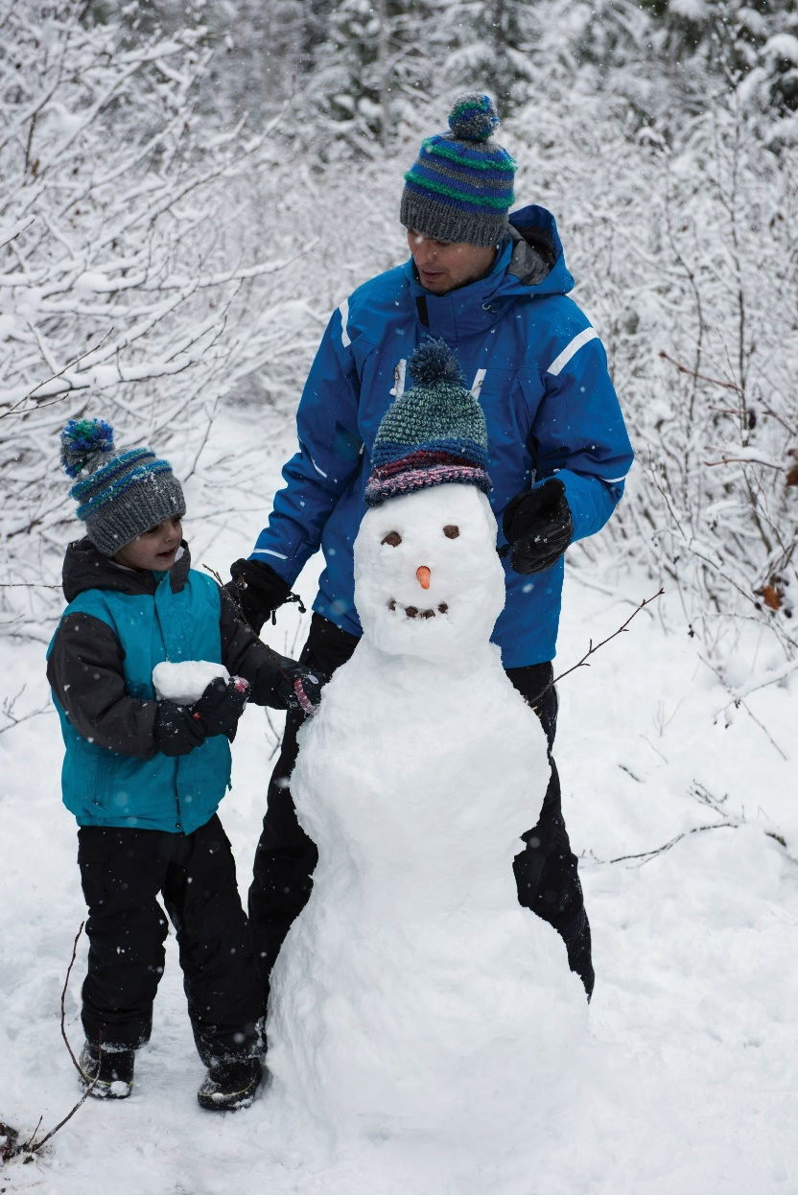
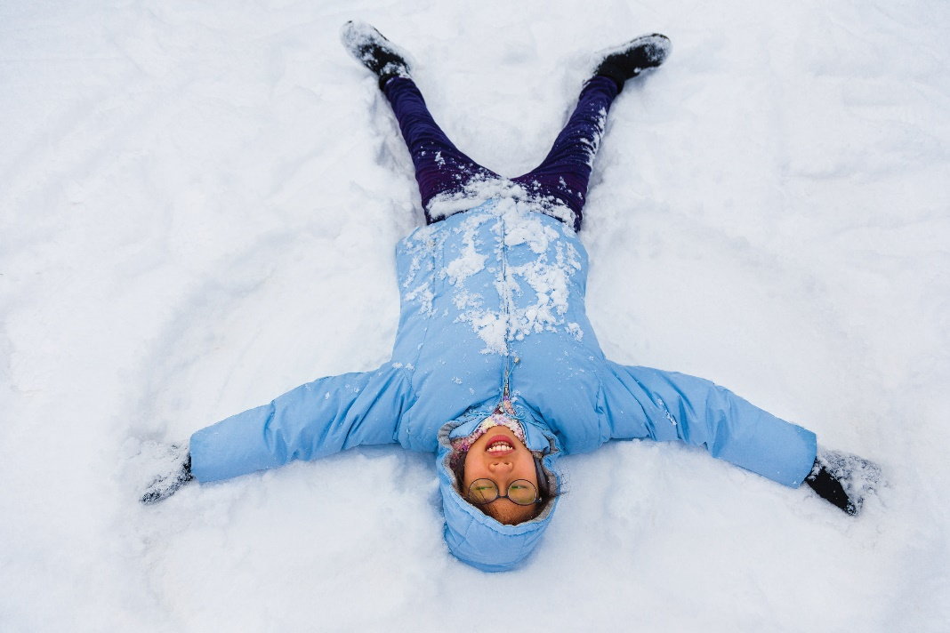
Snow

Slide 8
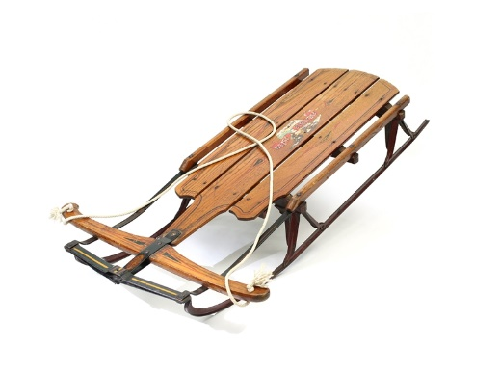
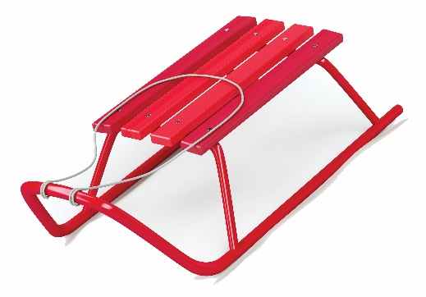
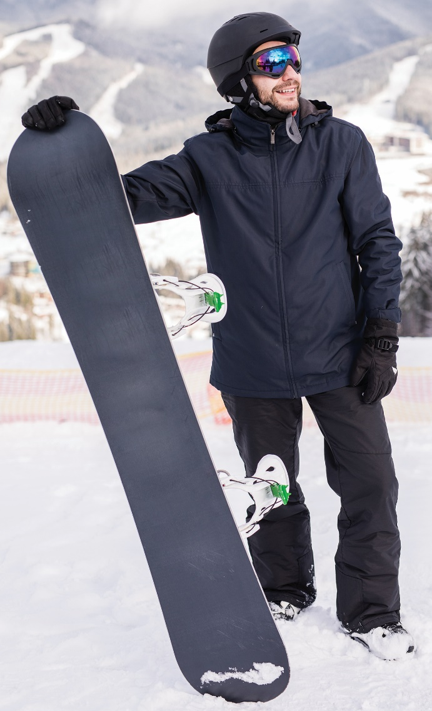
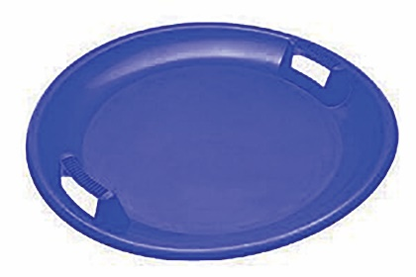
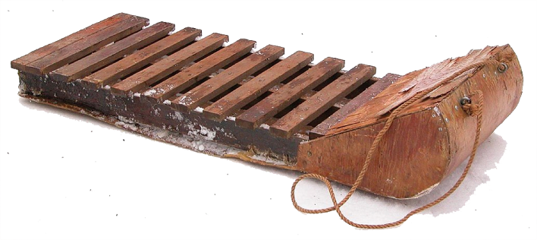
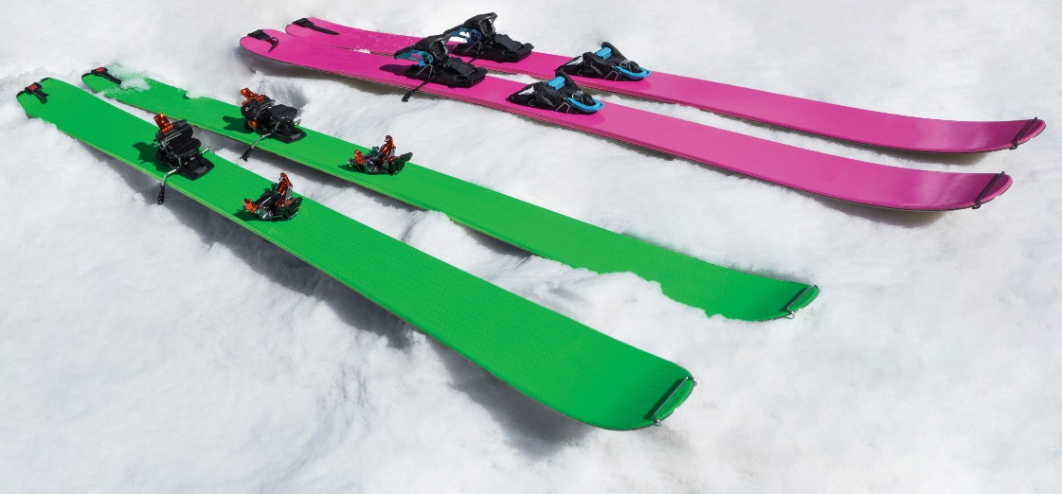
Snow

Slide 9
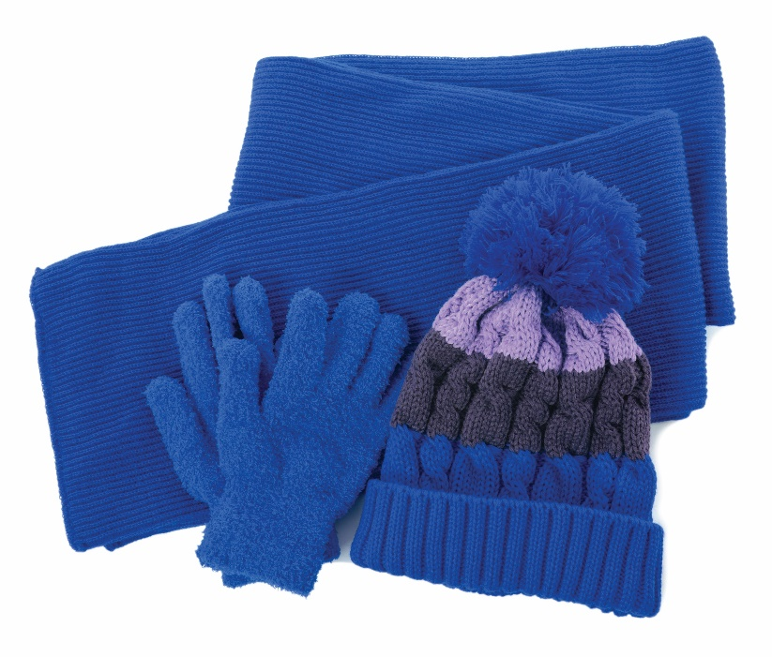
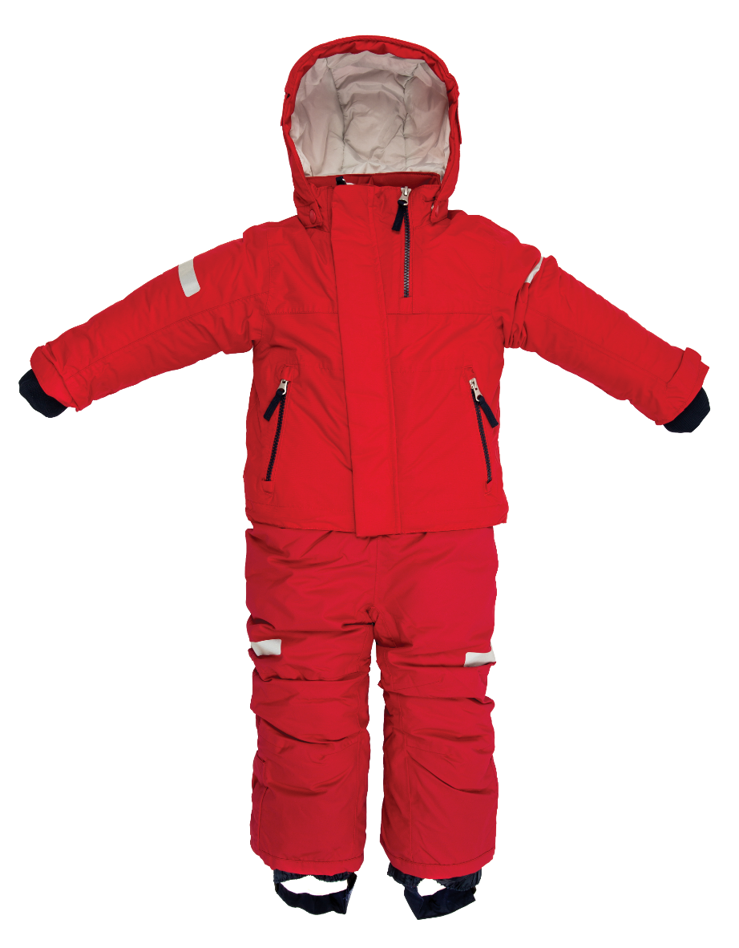
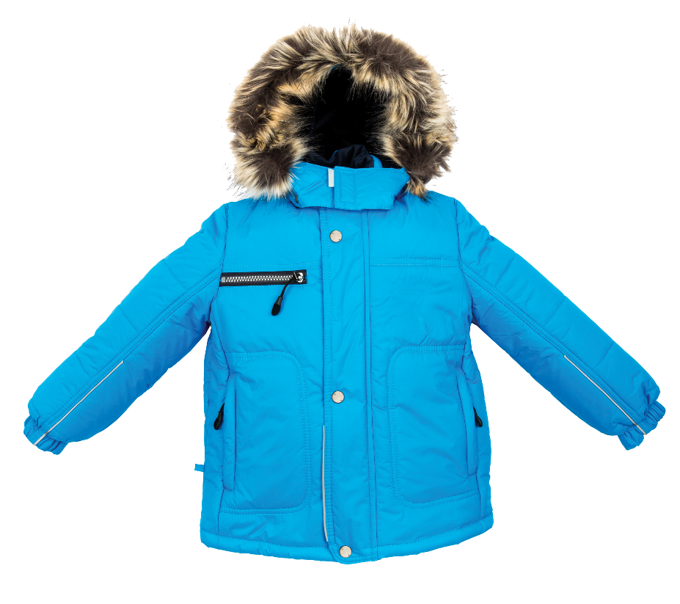
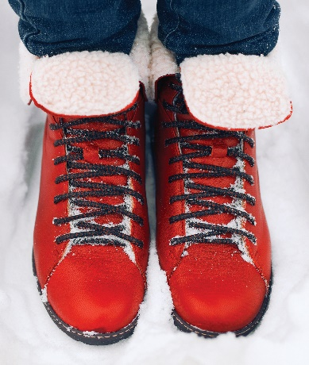
Snow

