Slide 1
The Pet Dog
© COPYRIGHT 2024 by Roxie Sporleder
Permission is granted to add, delete, or resize the pictures on the following slides.
^{Published by TeachingBasics} Battle Ground, Washington 98604 ^{E-mail: teachingbasics@mcn.net}
Photographs are from www.freepik.com as a premium user.
^{Slide 2: Traveling with a dog}
^{Slides 3 and 4: What dogs need}
Slide 5: Dogs love mud when it is hot.

Slide 2
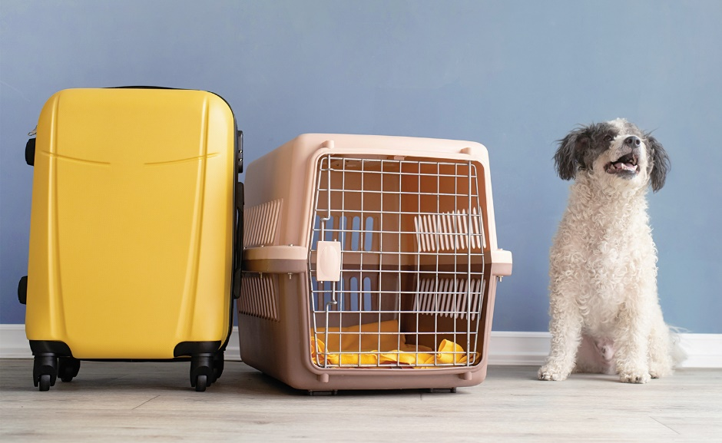
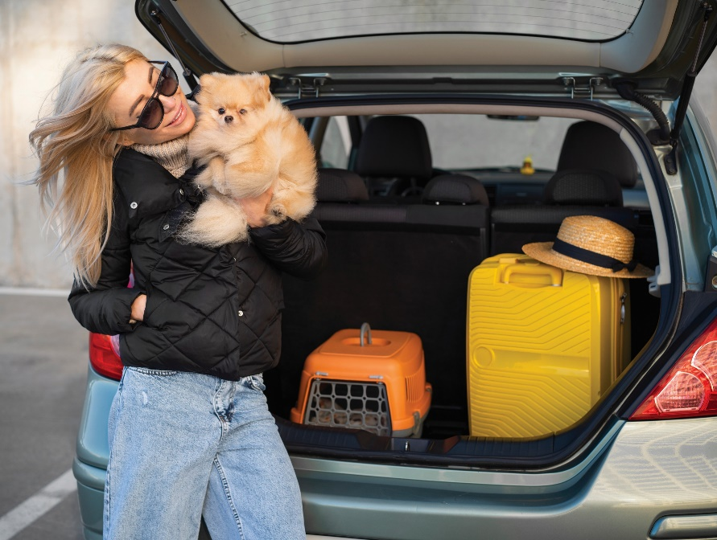
Dog

Slide 3
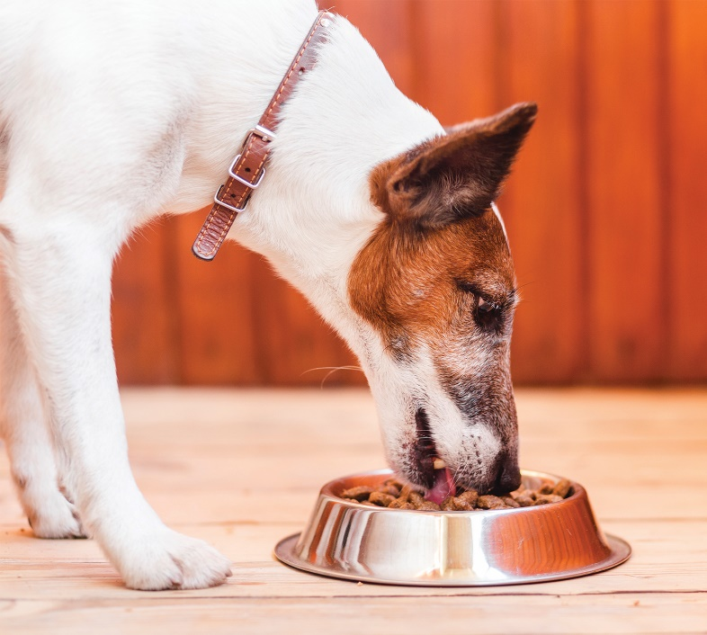
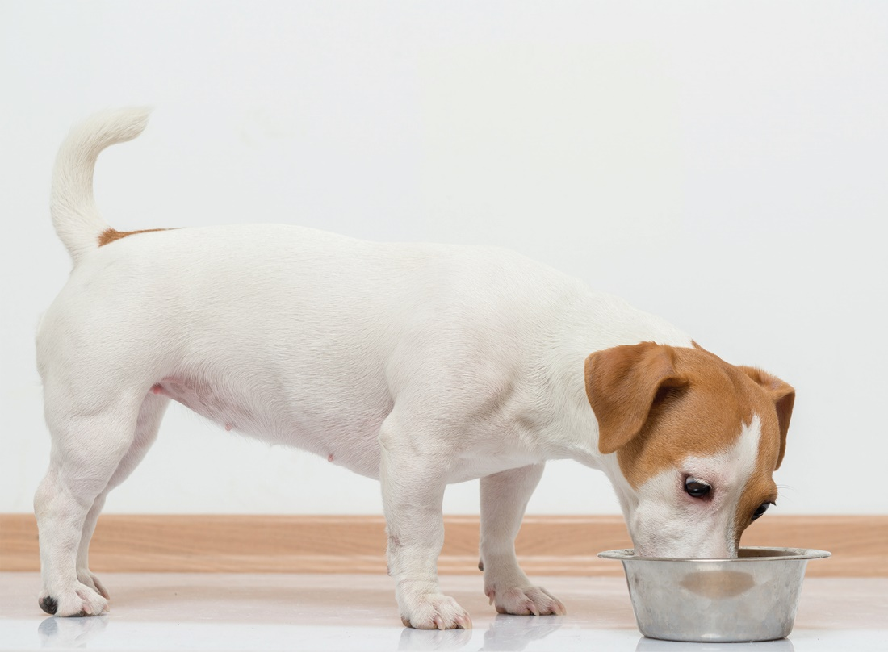
Dogs

Slide 4
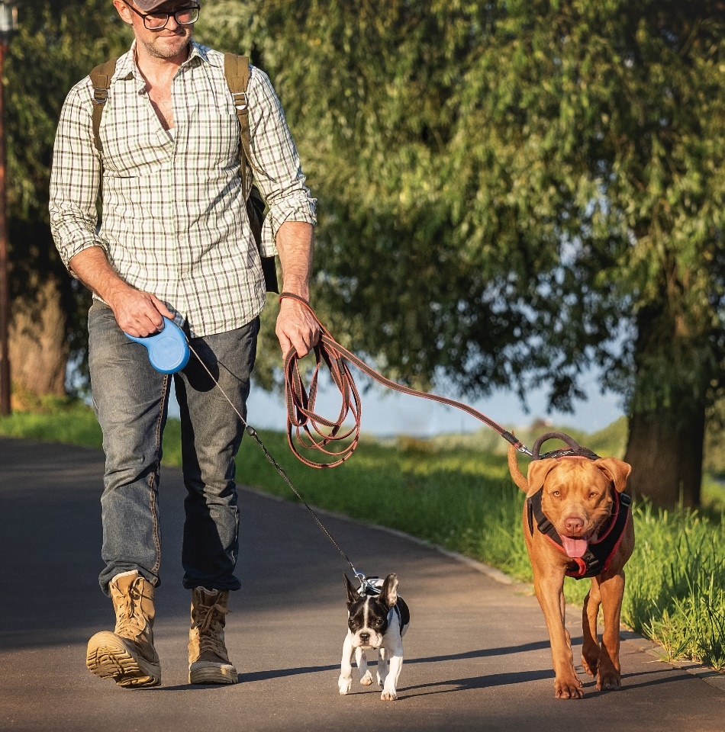
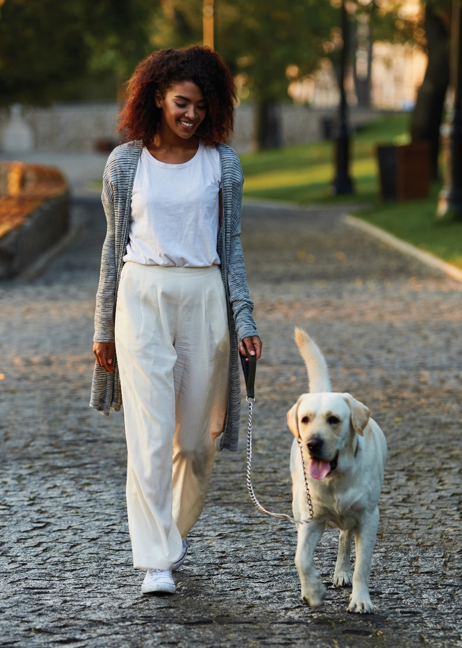
Dogs

Slide 5
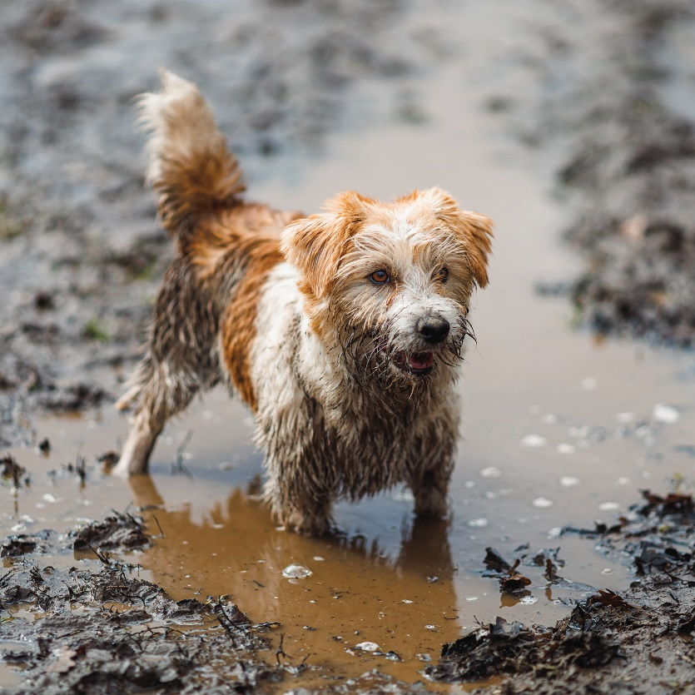
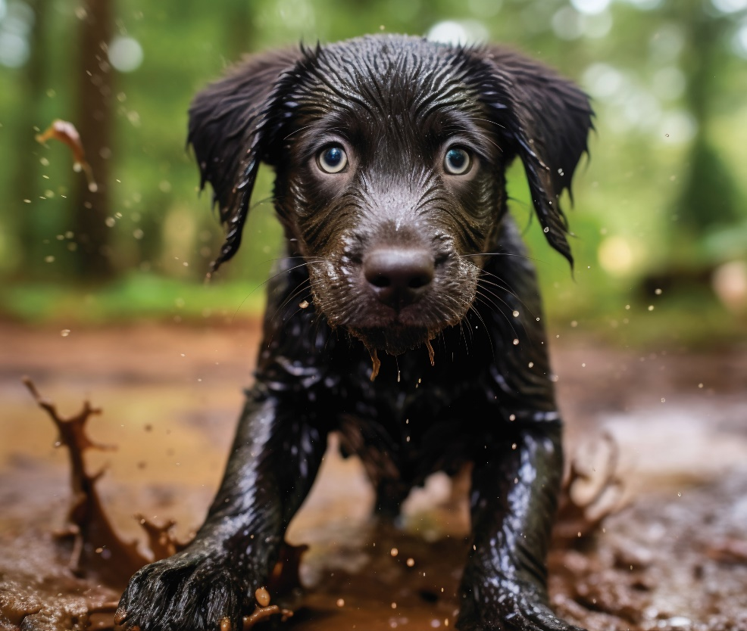
Dogs

