Slide 1
The Fox and the Bug
© COPYRIGHT 2024 by Roxie Sporleder
Permission is granted to add, delete, or resize the pictures on the following slides.
^{Published by TeachingBasics} Battle Ground, Washington 98604 ^{E-mail: teachingbasics@mcn.net}
Photographs and illustrations are from www.freepik.com as a premium user.
Slide 2: Shows a red fox, what they look like, and where they live.
Slide 3: Shows how a fox hunts at night.
Slide 4: Shows how foxes like to play with each other, with pet toys, and even jump on a trampoline.
Slide 5: Shows a dragonfly. How would you describe the dragonfly?

Slide 2
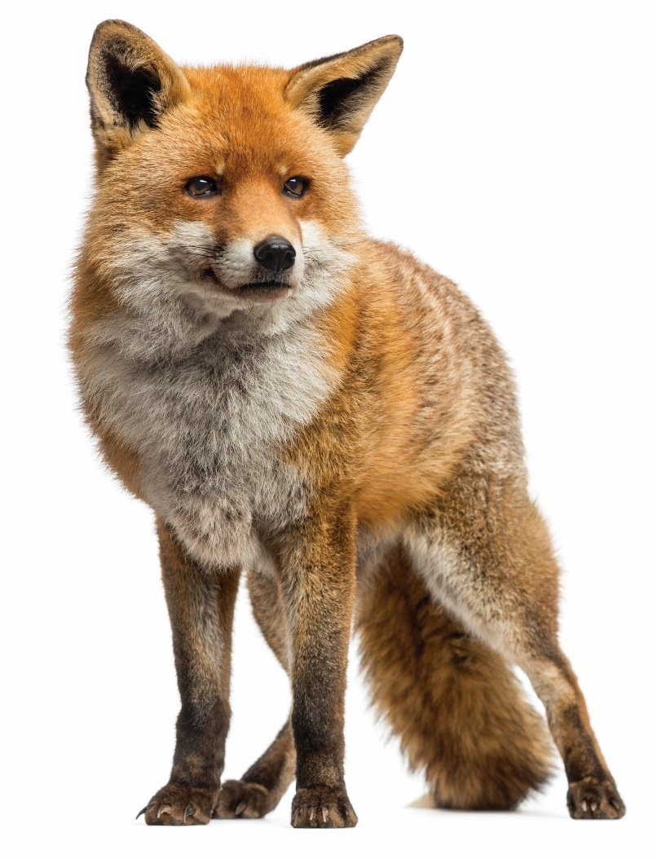
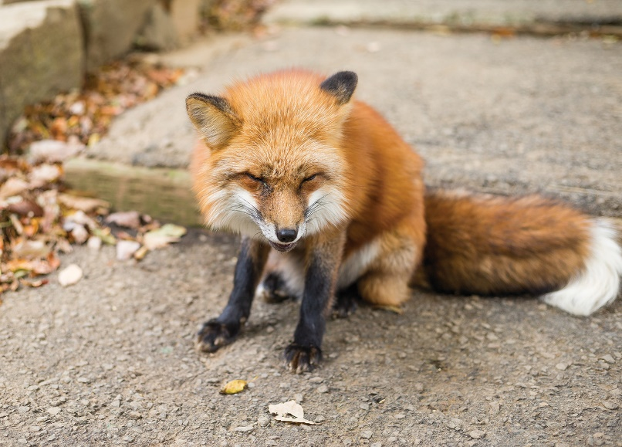
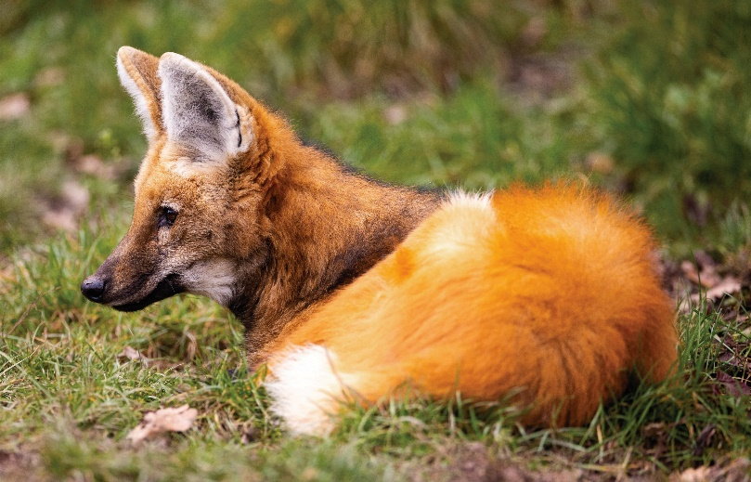
Fox

Slide 3
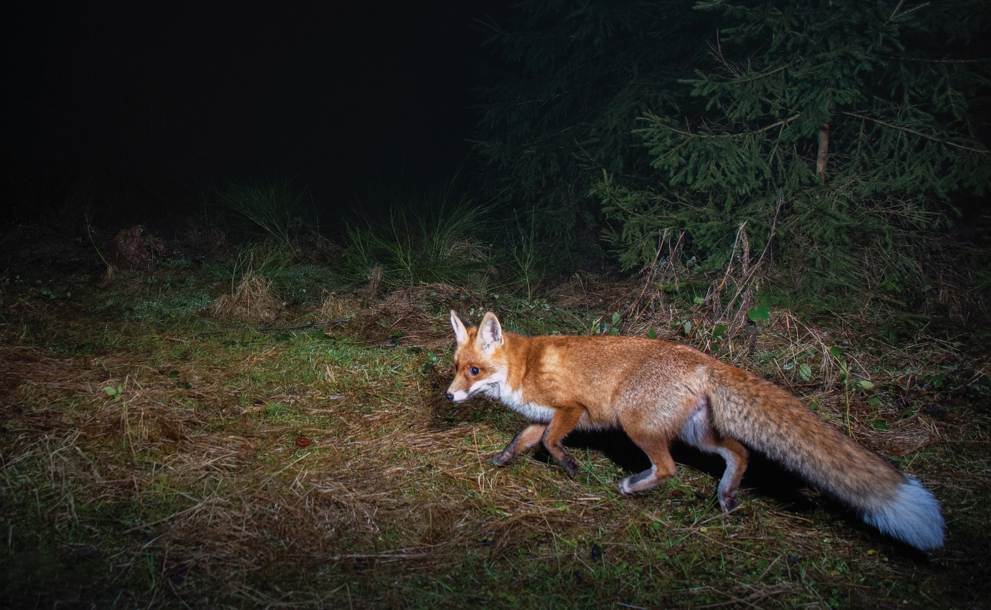
Fox

Slide 4
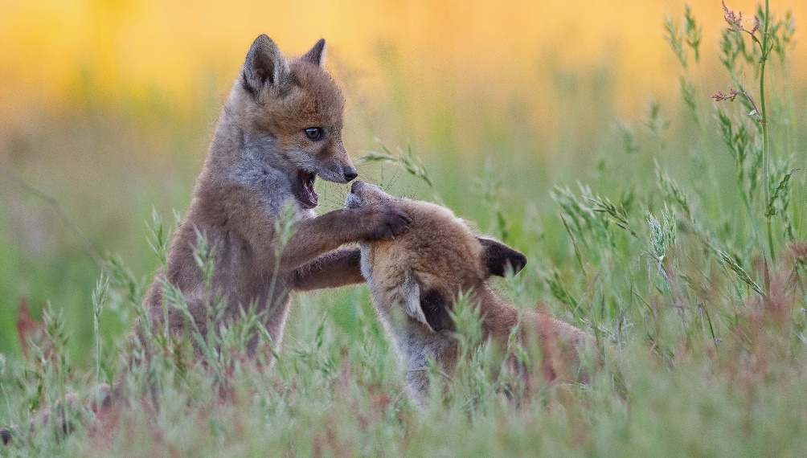
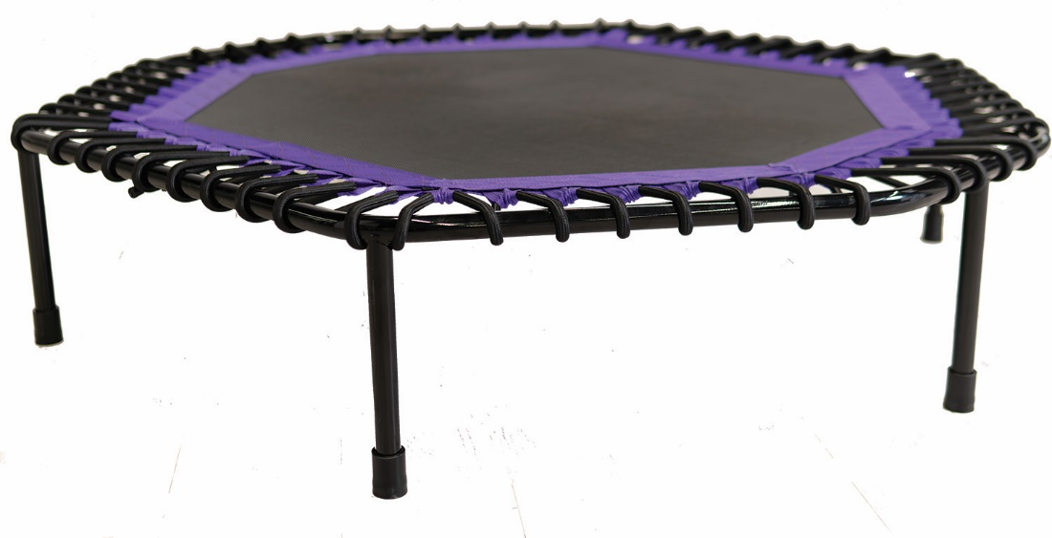
Fox

Slide 5
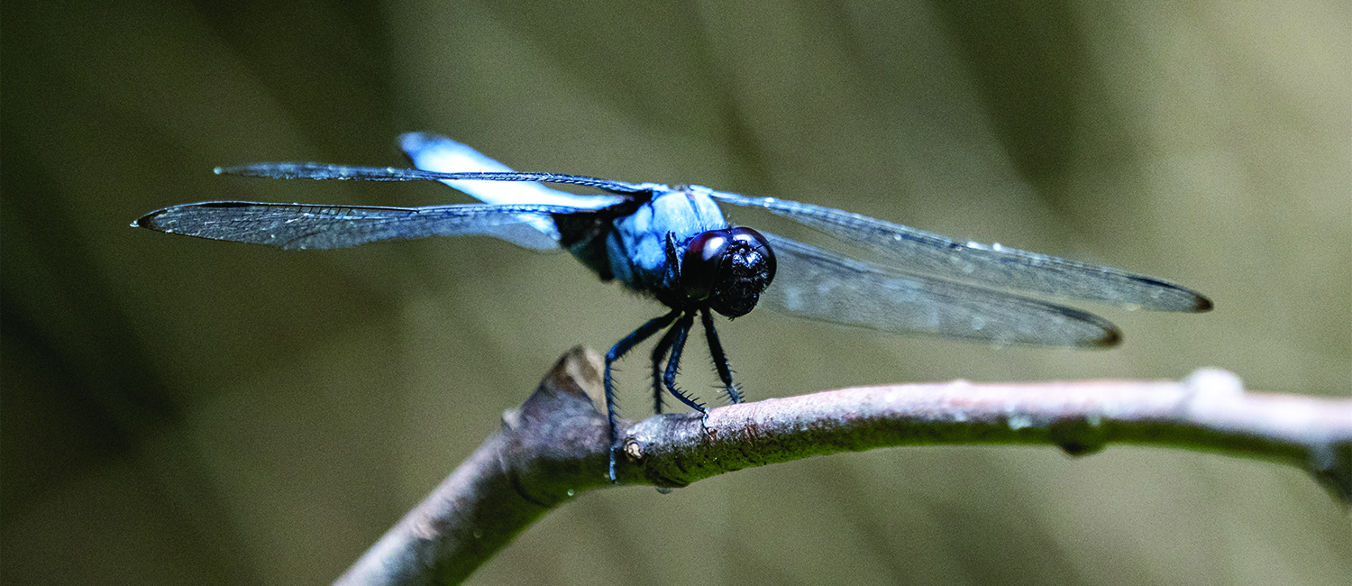
Bug

