Slide 1
The Soft Quilt
© COPYRIGHT 2024 by Roxie Sporleder
Permission is granted to add, delete, or resize the pictures on the following slides.
^{Published by TeachingBasics} Battle Ground, Washington 98604 ^{E-mail: teachingbasics@mcn.net}
Photographs are from www.freepik.com as a premium user.
Slide 1: Dogs on bed and couch. This may or may not be permitted by owner.
Slides 3 and 4: Were dogs are not to go and some of the problems that occur when they do go there such as unrolling the toilet paper, knocking over a plant, eating someone else’s food, or risking knocking over cup onto the computer.

Slide 2
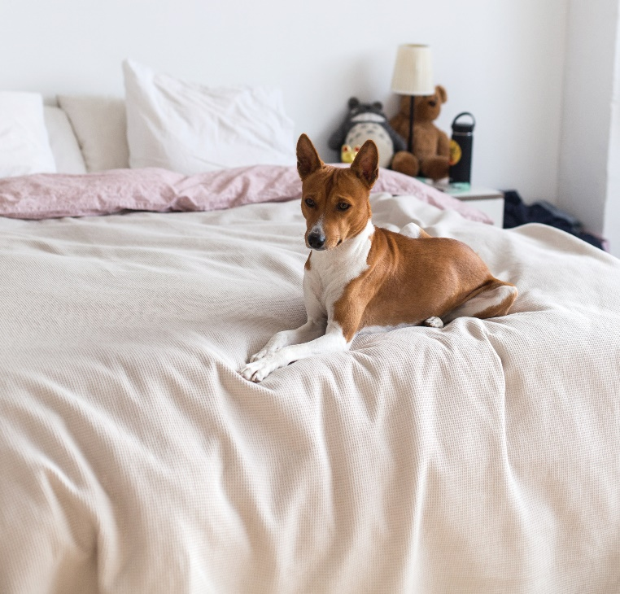
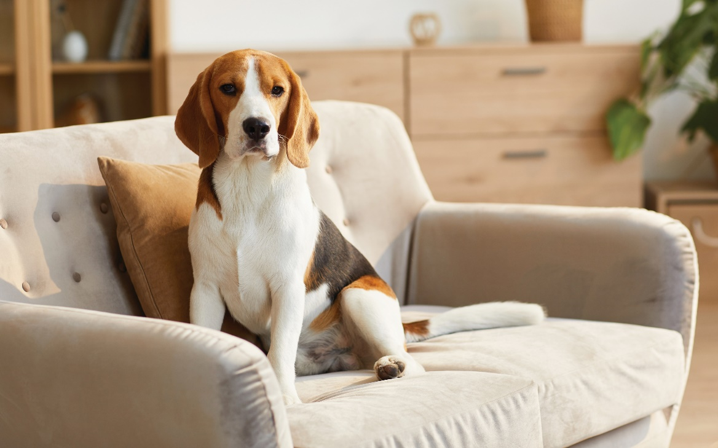
Dogs
Notes:
Some dogs are allowed to get on beds or couches. Sometimes they are not allowed. Why do you think they would not be allowed?

Slide 3
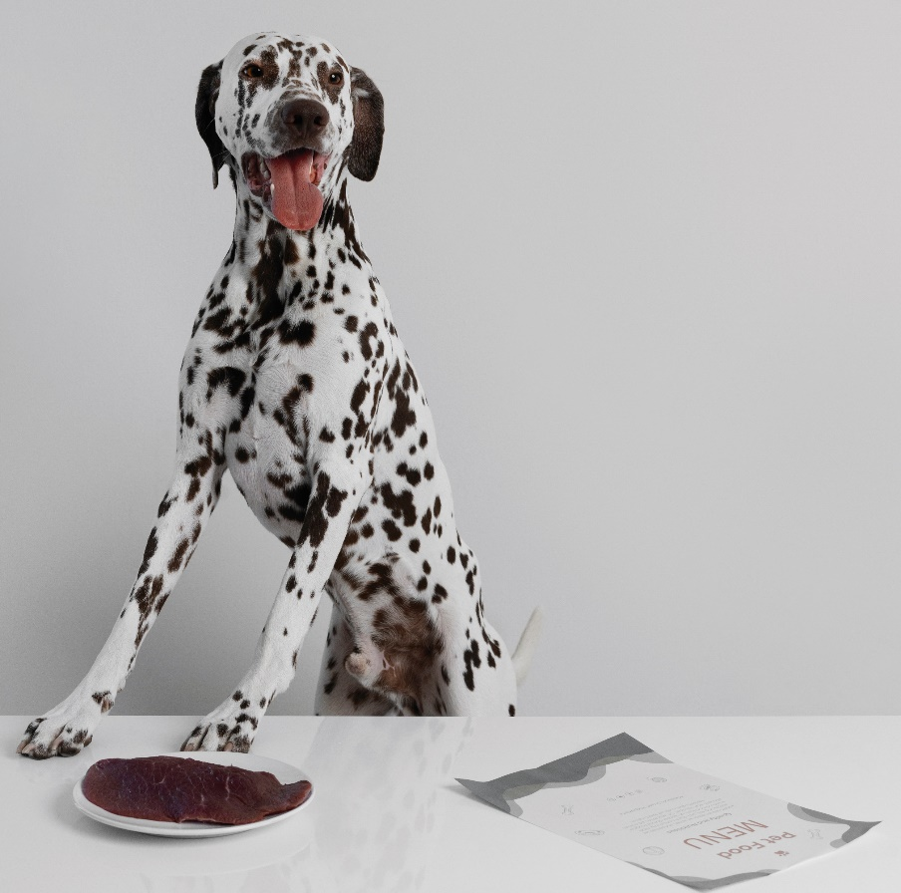
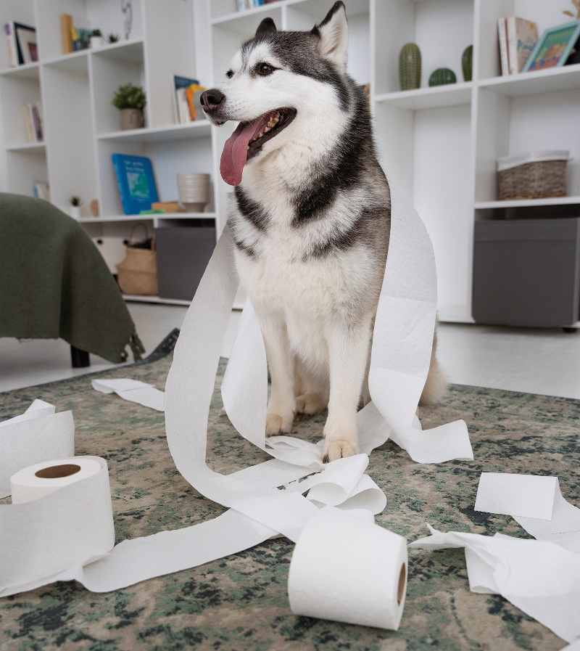
Dogs
Notes:
What are these dogs doing that they should not be doing?

Slide 4
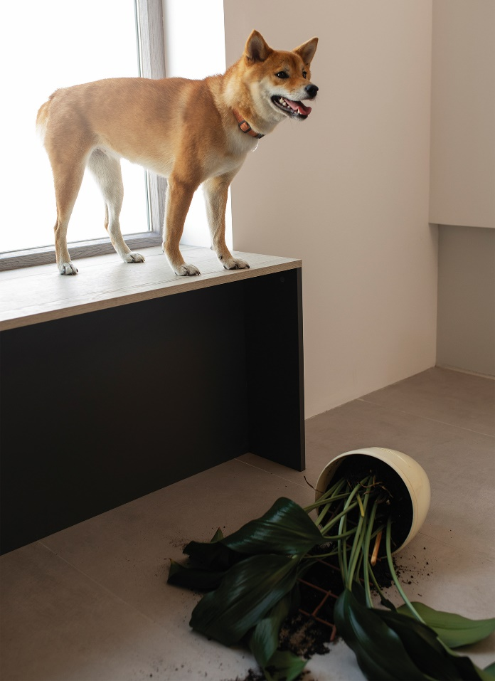
Dogs
Notes:
What are these dogs doing that they should not be doing? Where do you think the plant might be sitting? Why problems could happen with the dog and the computer?

